Slide 1
High Usage Reserves Stats
Python pandas to identify collection needs

Slide 2
Intro
Need for specialized stats
Dean’s Textbook Initiative
Python data science

Slide 3
Context and Reporting Need
Textbook Initiative
high cost of textbooks
Dean purchases textbooks
allows students to take courses they couldn’t otherwise
Work like regular reserves
Reporting need
Some titles will be high demand
Q: Which should we buy more of?
A: Find “borrowing bottlenecks” in loan transactions

Slide 4
Solution
Analytics report with transactions
Python script to count all copies on loan

Slide 5
Results
233 items/103 titles (unique editions) in Tectbook Initiative
206 items /84 titles circulated
~7,000 checkouts! In 2 years
Half had multiple concurrent checkouts
One quarter had times when all copies were checked out

Slide 6
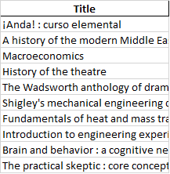
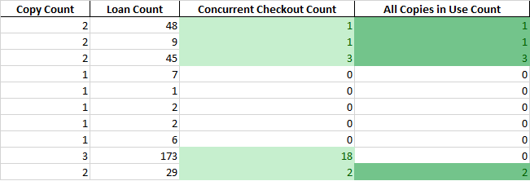
Results (cont.)

Slide 7
pandas/numpy
Support data science activities
Data exploration
Data preparation
Data representation
Data transformation
Python
“dataframe”
Tabular data with heterogeneously-typed columns
Numpy
Many methods to transform and analyze data in pandas dataframes

Slide 8
Future
Mashups with external data
Subject listings of circulated material with counts, vs. subjects taught at university?

Slide 9
Resources
Pandas
https://pandas.pydata.org/
https://pypi.org/project/pandas/
Github page
https://github.com/TuftsUniversity/high-usage-library-stats-alma-api

